Slide 1


OHIO LEGISLATIVE PROCESS
OHIO UNDERGROUND DAMAGE PREVENTION COUNCIL
BYERS, MINTON & ASSOCIATES
88 E. BROAD ST. SUITE 1650
COLUMBUS, OH 43215

Slide 2

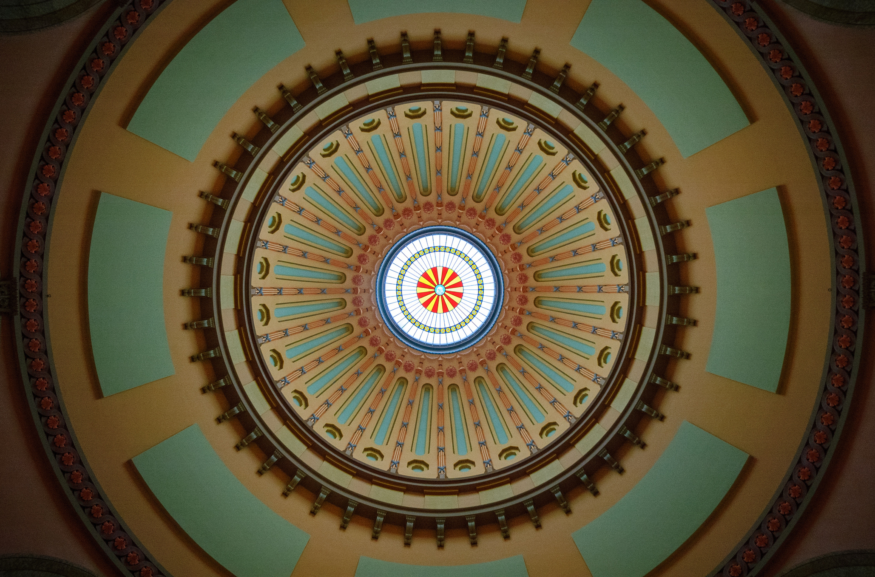
WHAT’S NEXT?
We have general agreement to move forward on subcommittee recommendations, what is our legislative timeline moving forward?

Slide 3

LEGISLATIVE TIMELINE
HOW MUCH TIME IS LEFT TO ACT?
OCT- DEC 2023
JAN - MAY 2024
NOV - DEC
2024
END OF 135th
2023-2024
  Legislature Returns
  Committees
  Session
  Nov. Election
  Committees
  Session
  Primary Election
  Campaign Season
  Committees
  Session
  Lame Duck
  Finalize Priorities
  Sine Die
  Prep for New GA
  Legislative Debrief
  Cont’d Advocacy?
14 Months*

Slide 4
WHY THE NEED FOR LOBBYISTS?
  All of us belong to a “special interest” whether it’s a personal passion or professional endeavor.
  “Lobbyists” have a unique, expert knowledge of government operation and procedures.
  ”Interests” have in-depth knowledge about that particular profession/sector/skill set/industry, but lack of time to understand government operational details, attend committees, travel to testify, etc.
    Those “interests” whether organization or individual have the same constitutional right to petition the government. Their right is represented through counsel/advisor/professional who ensure policymakers hear and consider their point of view.
  Elected Leaders recognize they don’t have a “monopoly on good ideas” and good public policy considers the perspectives of multiple viewpoints.

Slide 5


LEGISLATIVE PROCESS
ABOUT US
GOVERNOR’S APPROVAL/VETO
CONFERENCE COMMITTEE?
CHAMBER-TO-CHAMBER
FLOOR DEBATE & VOTE
COMMITTEE VOTE
COMMITTEE REVIEW
IDEA & INTRODUCTION

Slide 6
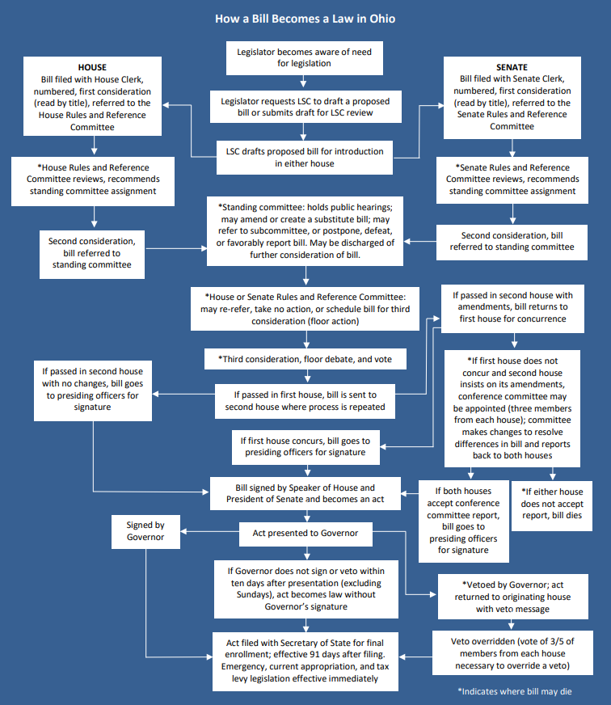
HOW A BILL BECOMES A LAW: REALITY

Slide 7
QUESTIONS
Greg@byersminton.com
www.byersminton.com
88 E. Broad St., Suite 1650

