Slide 1



Understanding House Bill 227
Key Enhancements to Ohio's Damage Prevention Laws

Slide 2


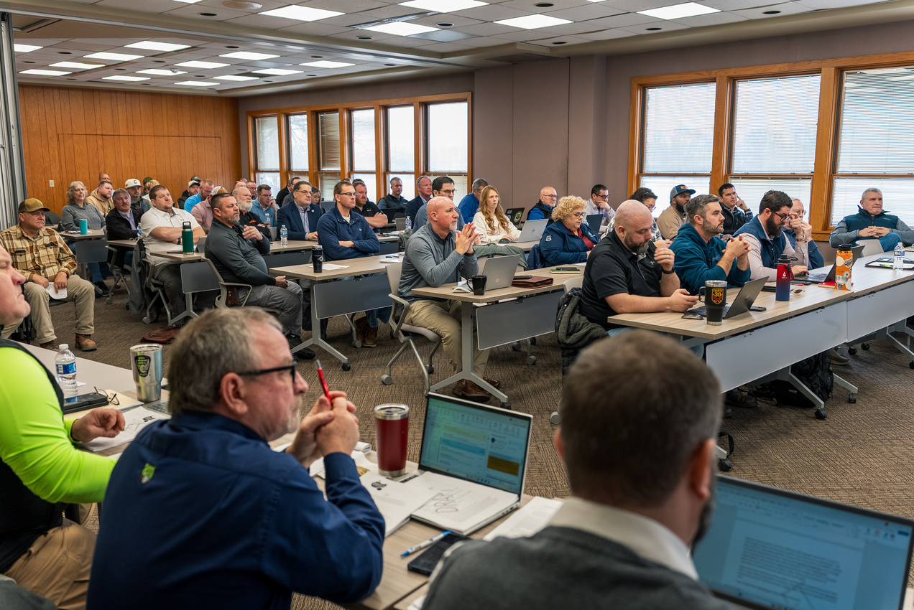


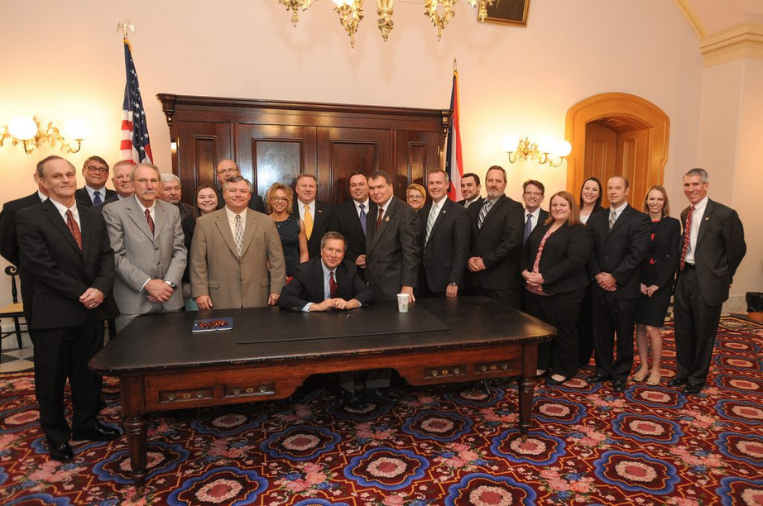


How House Bill 227 Came Together
Ohio Underground Damage Prevention Coalition (OUDPC)
Established in 2011, the OUDPC is a collaborative group of industry leaders, stakeholders, and advocates dedicated to enhancing safe excavation practices through meaningful updates to Ohio’s excavation laws. OHIO811 serves as the secretary for the OUDPC and is instrumental in facilitating and documenting these industry-wide discussions.
House Bill 227’s language emerged from initial OUDPC talks, refined in subcommittees and at the Coalition level. Underground utility stakeholder associations provided essential feedback and suggestions, which were reviewed and incorporated until proposed language was ready for bill consideration.
The OUDPC’s Impact on Safety
Get Involved!
The OUDPC’s efforts have been very successful, resulting in the passage of several significant pieces of legislation, including HB 458 (2012), SB 378 (2014), Sub HB 430 (2021) and some provisions within HB 315 (2024).
The Coalition continues their work advancing conversations that enhance excavation safety. Scan to learn more about the OUDPC & become involved.
Understanding HB 227 - OHIO811

Slide 3
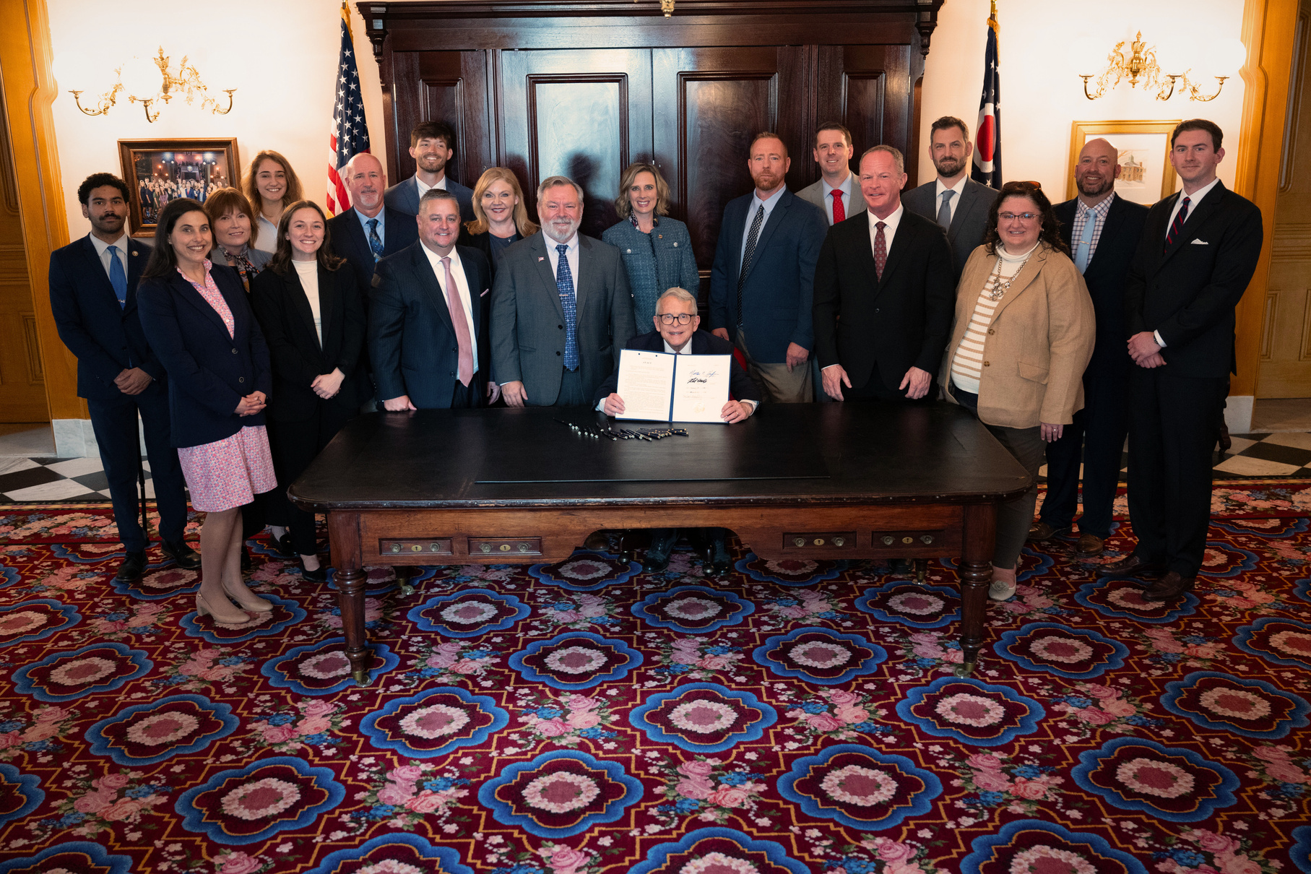




House Bill 227 Timeline
Effective June 09, 2026
House Bill 227 is a public safety initiative created by the industry, for the industry, and of the industry.
Sponsored by House Representatives Monica Robb Blasdel and Mark Johnson, the bill focuses on clarifying excavation laws, improving compliance standards, and reducing process inefficiencies that strain contractors, utility locators, utility operators, and excavators.
01
HB 227 Introduced
House Bill 227 was introduced in the 136th General Assembly on April 7, 2025. After unanimously passing the House, the bill unanimously passed the Senate, and unanimously passed concurrence.
02
HB 227 Signed Into Ohio Law
On March 10, 2026, Governor Mike DeWine signed House Bill 227 into law and it goes into effect on June 09, 2026.
Understanding HB 227 - OHIO811
Notes:
What is HB 227?:
- A public safety bill aimed to bring clarity to excavation laws/enhance clarity in ______, reduce strains in the name of public safety
!! - Focal point is providing safe environment for those living & working in Ohio
- Passed unanimously in the house, senate, concurrence...
- widely supported due to:
- focus on safety for the ## people living and working in the state
***Exemptions apply to the ENTIRE INDUSTRY-- not just the utility company
How Does This Affect Me?
How Does This Affect the Industry?

Slide 4






ORC 3781.28 (A)
Notification Timelines
“...at least two working days, not including the day of the notification, but not more than sixteen calendar days before commencing excavation...”
Utility Response Time - 2 Working Days
Excavation Start-by Date - 16 Calendar Days
Amends 48-hour notification timeline to “2 working days, not including the day of the notification”.
Changes the mandated excavation start-by date from 10 working days to 16 calendar days.
  Provides a true 2 days for utilities & utility locators to respond to 811 notifications
  Eliminates confusion surrounding holiday schedules
  Excavators will average 2 extra days to commence their excavation
  When other states made similar law updates, excavators experienced a 35% improvement in on-time locates
Understanding HB 227 - OHIO811

Slide 5



ORC 3781.25 (F)
Definition of Working Days
The updated definition establishes that a working day begins at 12:00am and ends at 11:59pm and excludes weekends and legal holidays, as
defined in ORC 1.14
This change supports the shift from 48 hours to two working days (not including the day of the notification) by clearly defining when those two working days begin and end.
The Result:
  A consistent understanding of what qualifies as a “working day”
  Clearer communication across all stakeholders
  Greater clarity around the official start of the 2-day notification requirement
Understanding HB 227 - OHIO811

Slide 6
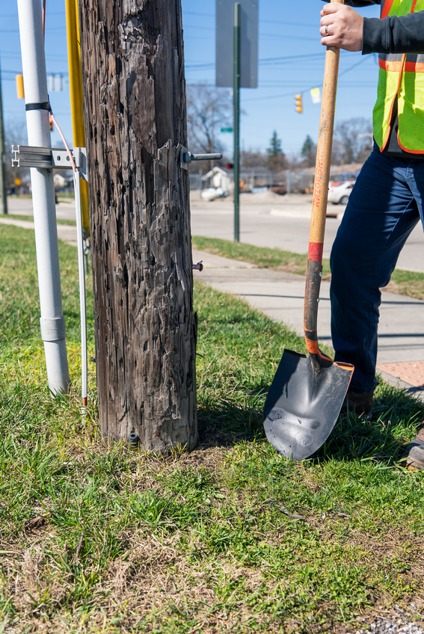
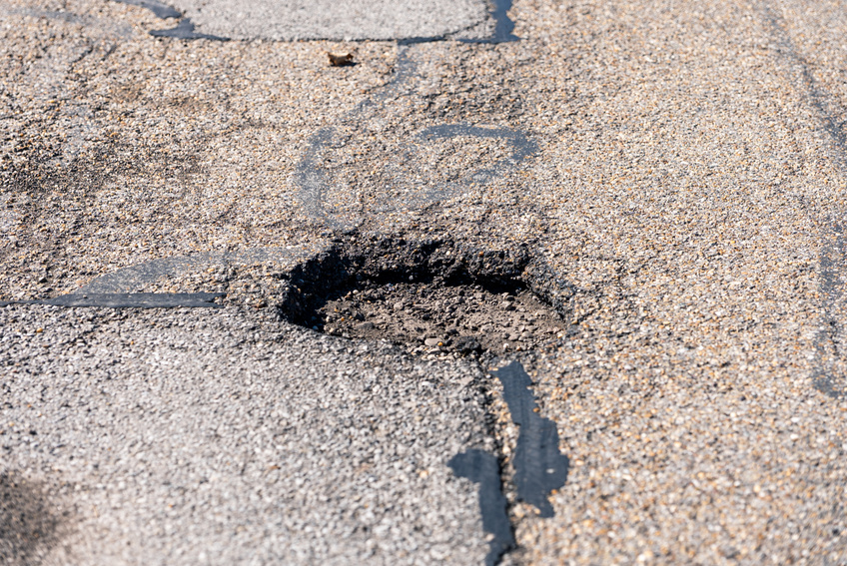



ORC 3781.25 (I)
Definition of Excavation & Exemptions
HB 227 updates the definition of excavation by removing the blanket exemption for governmental entities and replacing it with a clearly defined list of low-risk exempted activities applicable to the entire industry, not just utilities.
Exempt Activities, when performed in the public or utility right-of-way:
  Milling and grinding of road surfaces, without penetrating the earth or sub-base:
Interstate routes | up to 12'’
Multi-lane routes outside of municipal corporations | up to 6'’
Multi-lane divided routes inside municipal corporations | up to 6'’
All other roadways | up to 6'’
  2. Utility wood pole inspections working on the clear side of poles and using hand tools (up to 12")
  3. Shallow tilling for erosion control or beautification (up to 4")
  4. Temporary signage placement (up to 4")
  5. Localized pavement repairs outside municipal corporations, without penetrating the earth or subbase (up to 12")
  6. Activities conducted solely in response to a valid notification*
Such as: When the intent is to direct connect
to a tracer wire to perform a locate.
    Provided the activity solely uses hand tools
  7. “...Activities conducted entirely within twelve inches in any horizontal direction and twelve inches in any vertical direction from an existing, exposed, or visible utility appurtenances*...”
    Provided the activity solely uses hand tools
(6) and (7): “...shall apply irrespective of whether the activity occurs within or outside the boundaries of the road right-of-way...”
Understanding HB 227 - OHIO811
This change maintains safety and compliance standards and restores Ohio’s eligibility for federal grant funding through Pipeline and Hazardous Materials Safety Administration (PHMSA)

Slide 7
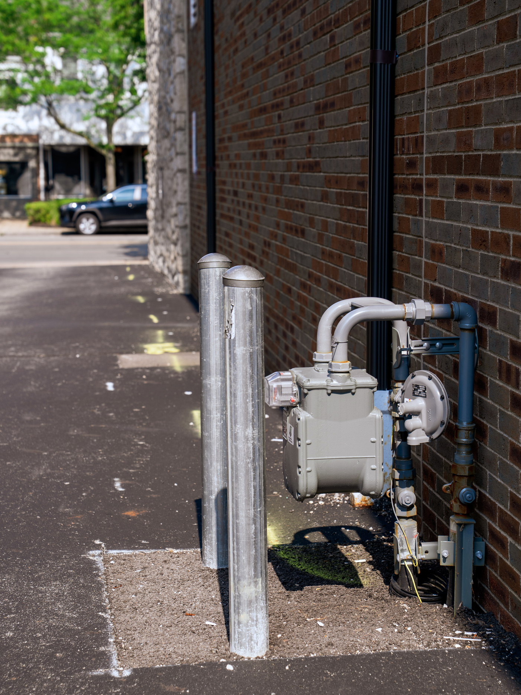
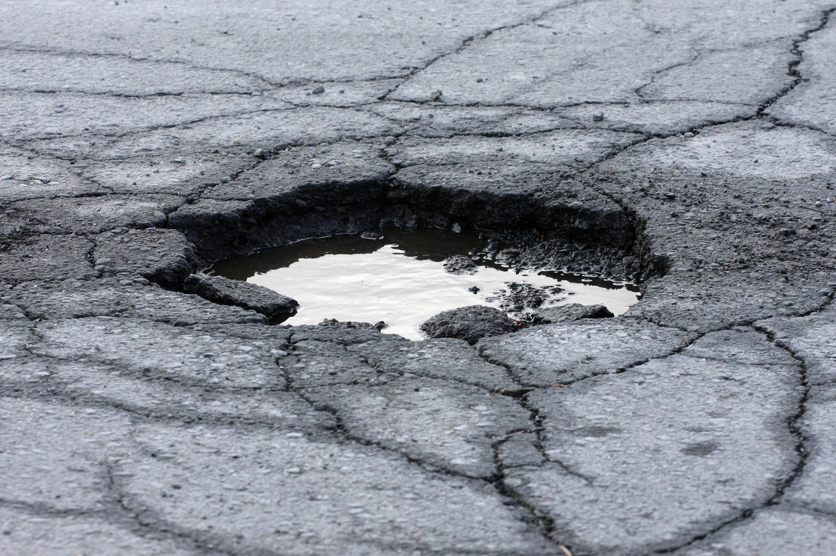
Definition of...
ORC 3781.25 (Z)
“Utility appurtenances”
“’Utility appurtenances’ means the physical components and legal rights attached to a property that are necessary for providing utility services...”
  This includes items that allow utility companies to access properties for installation, maintenance, and repair like, but not limited to: utility poles, meters, valves, electrical boxes, and pedestals.
ORC 3781.25 (AA)
  “Localized pavement repair”
"’Localized pavement repair’ means repair of areas of pavement requiring deeper removal in order to correct a pavement deficiency that is not common or cannot be sufficiently repaired in the overall pavement milling area of work.”
Understanding HB 227 - OHIO811

Slide 8
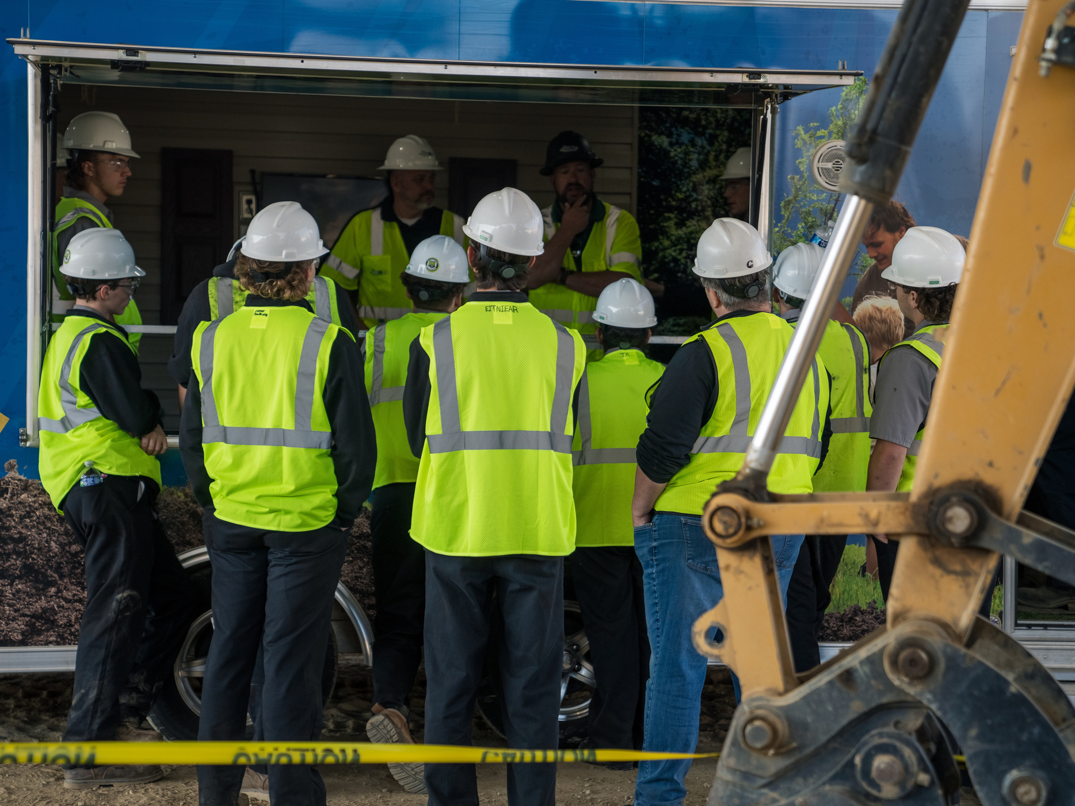
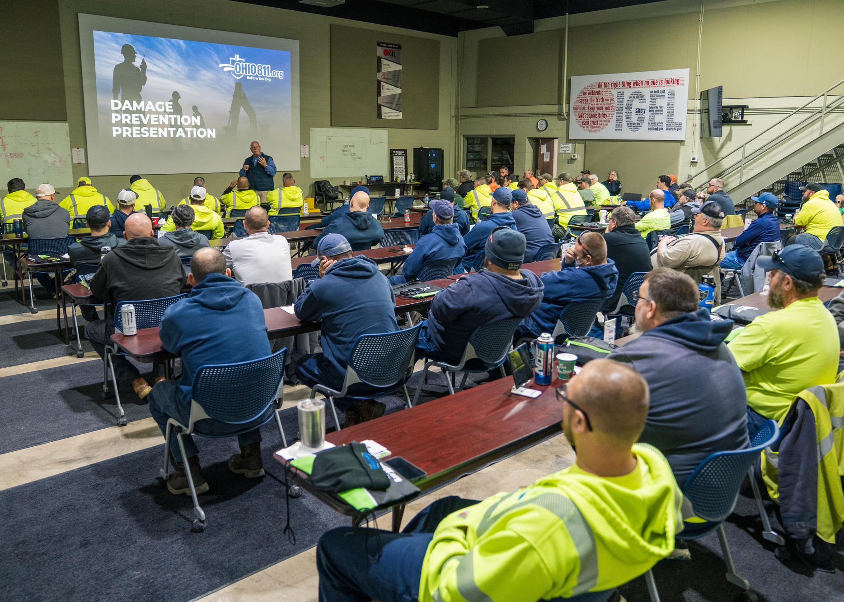
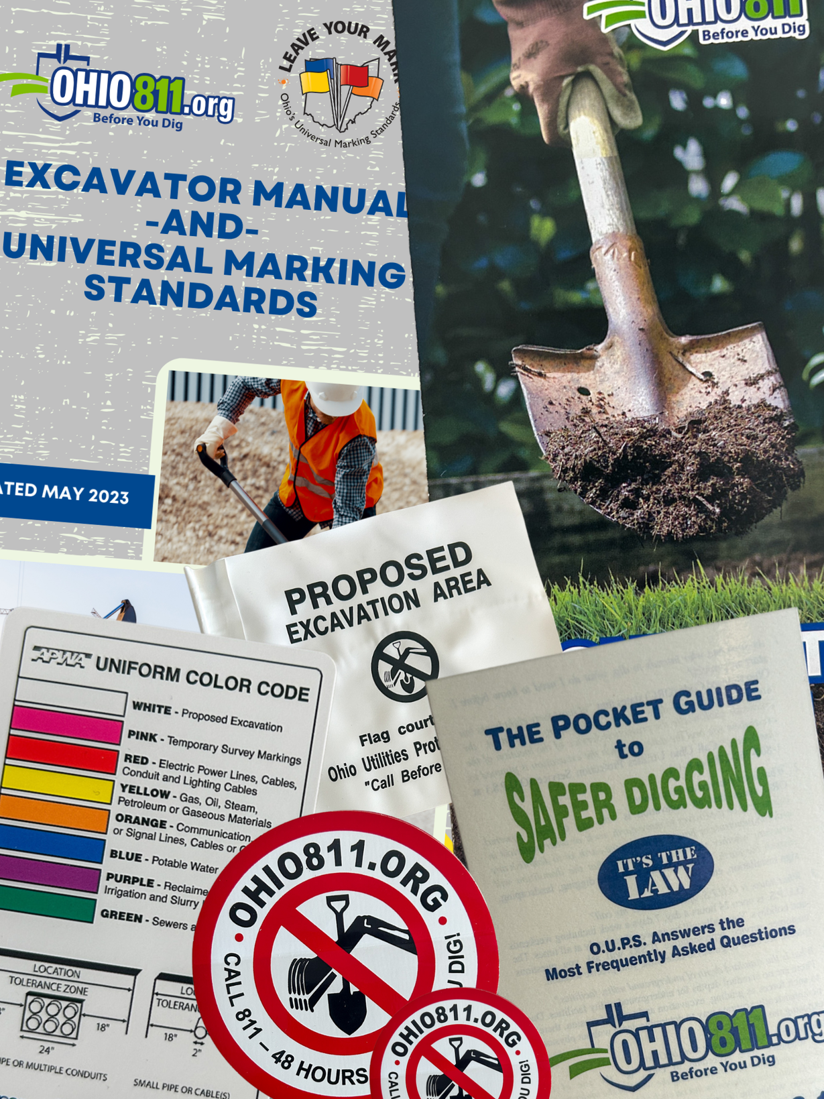


ORC 3781.261
Protection of Underground Utility Facilities Training
Further clarifies existing ORC training requirements and mandates standardized training across all who have a responsibility to the 811 notification process.
Employee training requirements shall be:
Requires employers to provide and document employees training:
  The one-call OHIO811 notification process
  Responsibilities of utilities & excavators
  Positive Response system
  The Ohio Universal Marking Standards
which is to be provided at the time of initial assignment, every five years thereafter, or whenever changes occur to Chapters 3781. or 4913. of the Revised Code.
  The laws & regulations described in sections 153.64 and 3781.25 to 3781.34 of the Revised Code
Compliance failure with training requirements is enforceable (as defined in ORC 4913.01)
Understanding HB 227 - OHIO811

Slide 9
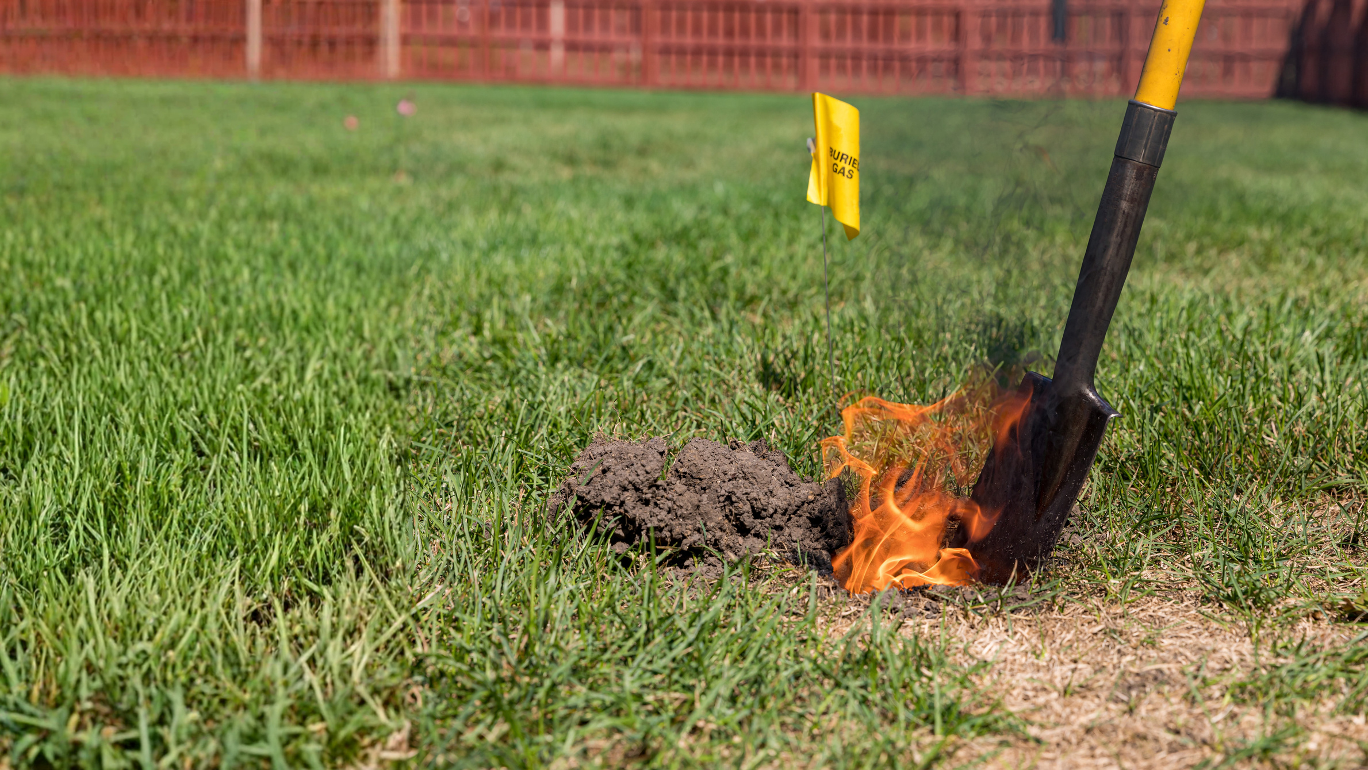
ORC 3781.30 (A) (6), (7), (8)
ORC 3781.30 (A) (6)
Duties of Excavator
Damages must be reported to OHIO811 (the protection service) in addition to notifying the utility*
Mandatory Damage Reporting
“As soon as any damage is discovered, including gouges, dents, or breaks to coatings, cable sheathes, and cathodic protection anodes or wiring, report the type and location of the damage to the utility and the protection service and permit the utility a reasonable amount of time to make necessary repairs...”
To strengthen accountability and improve statewide damage prevention efforts, HB 227 establishes a clear damage reporting framework within Ohio Revised Code 3781.271, and clarifies that failure to comply with reporting requirements is now enforceable as defined in Ohio Revised Code 4913.01.
ORC 3781.30 (A) (7)
Updates terminology from “law enforcement and fire department” to “emergency response agencies”.*
ORC 3781.30 (A) (8)
Compliance Requirements for Damage Reports
Mandated damage reports must include:
  Location of the damaged underground facility
  Type of underground utility facility damaged
    including size, material type, and color
  Approximate depth at which the damaged underground utility facility was encountered
Compliance failure with damage reporting requirements are enforceable (as defined in ORC 4913.01)
*ORC 3781.30 (A) (6) & (7) “...If the owner or operator of the [damaged] utility facility is unknown, notification to [OHIO811] satisfies the excavator’s reporting requirement to the utility...” OHIO811 will provide notice to the appropriate facility owner on the excavator’s behalf.
Understanding HB 227 - OHIO811

Slide 10


ORC 3781.271 (B) (C) & (D)
Damage Reporting Data
Modification of One-Call Notification System
To enhance accountability and strengthen excavation safety efforts, these provisions establish a structured approach to damage reporting data.
New statutory language adds sections (B), (C), & (D):
(B)
OHIO811 will collect and maintain a centralized database of underground facility damage notifications.
(C)
Compiled, nonconfidential damage data will be published on OHIO811’s web site.
(D)
Detailed reports will be available upon request to the Public Utilities Commission of Ohio (PUCO) and will remain confidential, except as permitted by law.
Understanding HB 227 - OHIO811

Slide 11

ORC 4913.01
Definitions
Clarifies definitions for enforcement consistency and ensures equal accountability amongst stakeholders.
ORC 4913.01 (A)
“Aggrieved person”
”Aggrieved person” includes all who have a responsibility in the 811 process who are directly involved in or impacted by the alleged compliance failure.
This definition encompasses sections 153.64, 3781.25 to 3781.32, which include training requirements and damage reporting.
Furthermore, the definition of ‘Aggrieved Person’ is expanded to include anyone with knowledge of a compliance failure as defined in ORC 4913.01(B):
“...’Aggrieved person’ includes any person when the alleged compliance failure is a failure to comply with the reporting requirements prescribed in divisions (A)(6) and (8) of section 3781.30 of the Revised Code.”
ORC 4913.01 (B)
“Compliance failure”
"’Compliance failure’ means a failure to comply with any provision of sections 153.64 and 3781.25 to 3781.32 of the Revised Code.”
Understanding HB 227 - OHIO811

Slide 12
Statutory Cleanup
HB 227 removes outdated “Limited Basis Participant” (LBP) language, aligning the statute with current one-call notification laws.
The passage of HB 458 in the 129th General Assembly mandated all utility members to receive excavation notifications directly from the protection service, eliminating the need for the LBP membership type.
  This cleanup eliminates antiquated language and solidifies standards among all utility members, creating clearer communications between the utility and the excavator.
Understanding HB 227 - OHIO811

Slide 13



HB 227 will go into effect:
June 9, 2026
More Information
Access other educational tools pertaining to HB 227 here.
Have questions? Please contact HB227@oups.org
Information provided by OHIO811 is meant to be general educational information only. It is not intended to provide legal advice, nor should it be relied upon to interpret the Ohio Revised Code, Chapters 153.64, 3781.25-38, or 4913, and additional upcoming law changes. To be clear, this documentation is not a substitute for the law or legal advice. Please refer to Ohio Revised Code, and legal counsel for guidance as you navigate the OHIO811 system.

